Slide 1



Fitness and Nutrition
Presented by
Lifestyle Fitness

Slide 2
What Exercise and Nutrition Can Do for You
Benefits
Programs

Slide 3

Benefits
Prevents heart disease and normalizes blood pressure
Regulates blood sugar and controls body weight
Prevents bone and tissue loss
Improves lifestyle

Slide 4

Regulate Blood Sugar and Control Body Weight
Improves body’s ability to metabolize sugar
Burns calories
Maintains weight-loss

Slide 5
Prevent Heart Disease and Normalize Blood Pressure
Slows plaque buildup in arteries
Increases “good” and decreases “bad” cholesterol
Decreases resting heart rate
Prevents obstructive blood clots
Makes heart stronger and more efficient

Slide 6
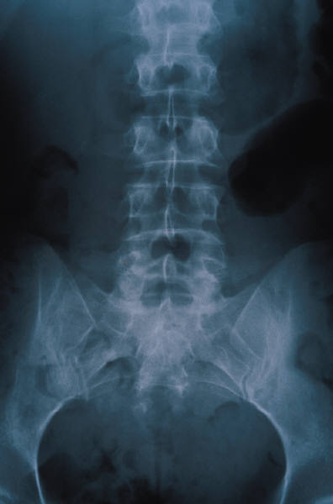
Prevent Bone and Muscle Tissue Loss
Prevents osteoporosis
Prevents loss of lean body mass
Prevents drop in metabolic rate

Slide 7
Improve Lifestyle
Makes activity easier
Increases stress resistance
Improves sleep
Encourages other healthy habits

Slide 8
Programs
Exercise
  Personalized fitness programs
  Group workout classes
    Spinning
    Kick Boxing
    Step Aerobics
    Yoga
  Running and racquetball clubs
Nutrition
  Healthy Choices
  Tips

Slide 9

Exercise Makes Life More Fun!
Start a regular workout program today
Join a workout group and share the health

Slide 10
Lifestyle Fitness

